Slide 1

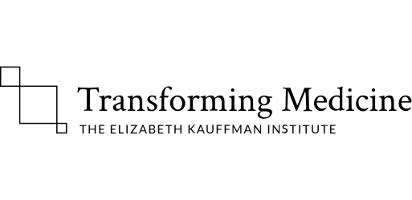


BIOM 262: 3/14/2017
Modern Applied Population Genetics
Nicholas J. Schork, Ph.D.
(JCVI, UCSD, La Jolla, CA; TGen, Phoenix AZ)
Views on Global Human Genetic Variation and Lewontin’s Studies & Fallacy
2. Global Human Functional Genomic Diversity: Stratification and Its Consequences
3. Admixture: Characterization, Consequences and Admixture Mapping
Population Genetics and Evolutionary Genetics: Integration and Impact

Slide 2
3. Admixture: Characterization, Consequences and Admixture Mapping

Slide 3
Using Genetic Variation to Trace Migration and Admixture

Slide 4
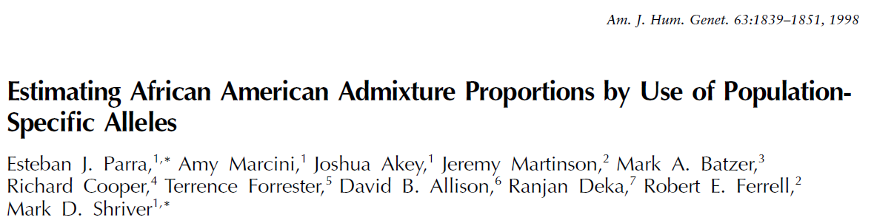
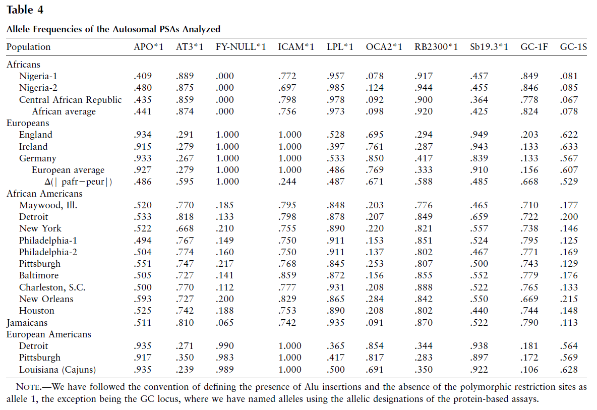

Slide 5
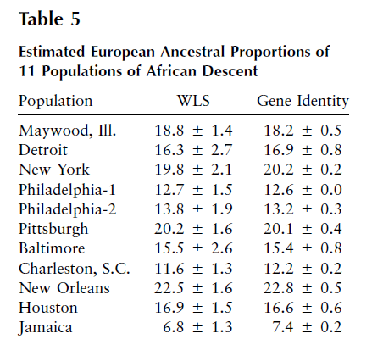
Genetic variants that unique, or more common in, certain populations have been identified
Panels of such markers that have “population specific alleles” in them have been devised
These markers are “ancestry informative” for the population they have been chosen to be unique or more common in
An individual can be genotyped for these markers
The number of variations an individual possesses that are associated with the population in question is an estimate of the degree of ancestry for that person for that population
Repeating this for many population specific AIMs can be used to estimate how “admixed” an individual is

Slide 6
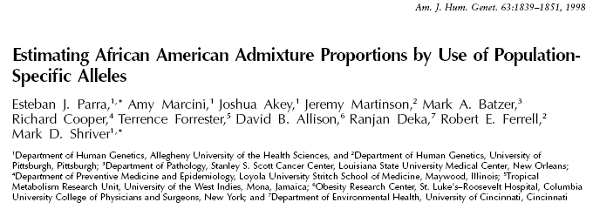
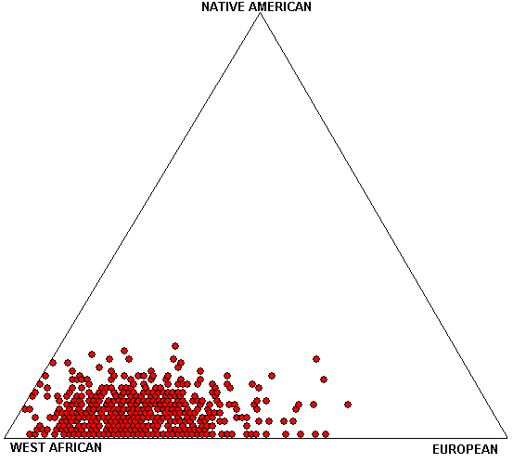
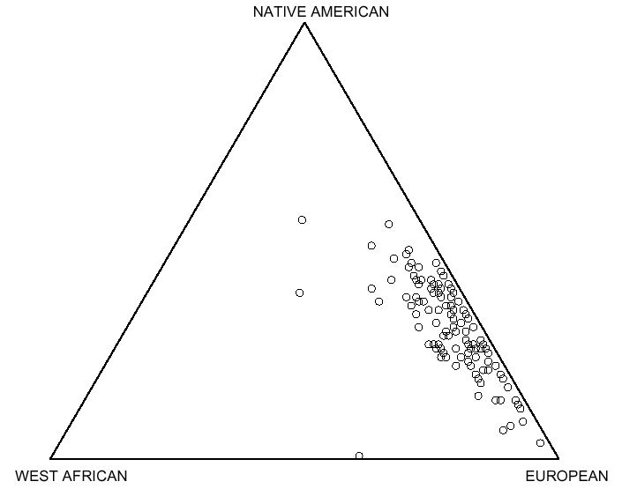
Example Admixture Studies Using AIMs: African Americans and Costa Ricans
Chicago African Americans
(Halder, Shriver, et al. unpublished)
Costa Ricans
(Shriver, et al. unpublished)
African Americans have genomes ‘between’ West Africans and Europeans but vary in degree of admixture
Costa Ricans have genomes ‘between’ Native Americans and Europeans but vary in degree of admixture

Slide 7
Estimating ‘Degree’ of Admixture Using Ancestry Informative Markers (“AIMs”)
Genetic variants that unique, or more common in, certain populations have been identified
Panels of such markers that have “population specific alleles” in them have been devised
These markers are “ancestry informative” for the population they have been chosen to be unique or more common in
An individual can be genotyped for these markers
The number of variations an individual possesses that are associated with the population in question is an estimate of the degree of ancestry for that person for that population
Repeating this for many population specific AIMs can be used to estimate how “admixed” an individual is

Slide 8
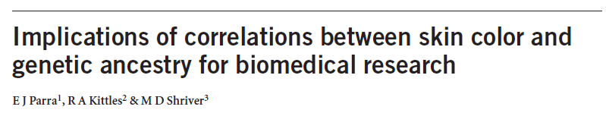
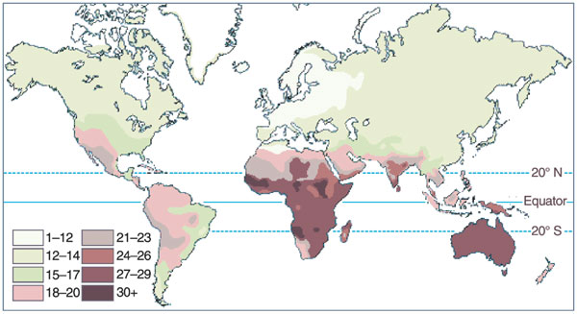
Global map of skin pigmentation levels

Slide 9
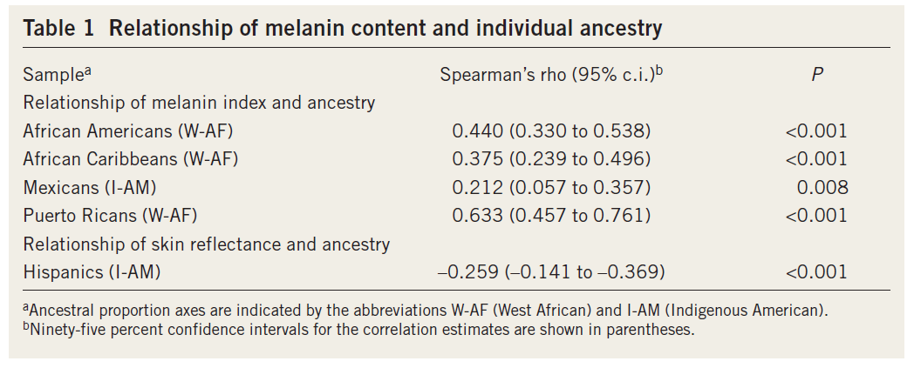

Slide 10
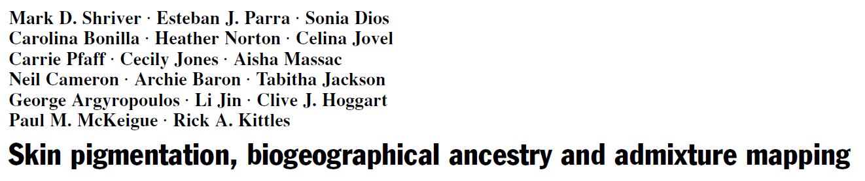
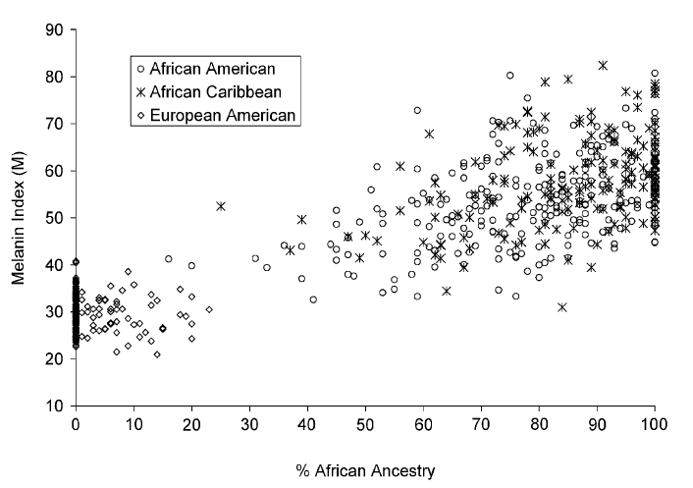

Slide 11
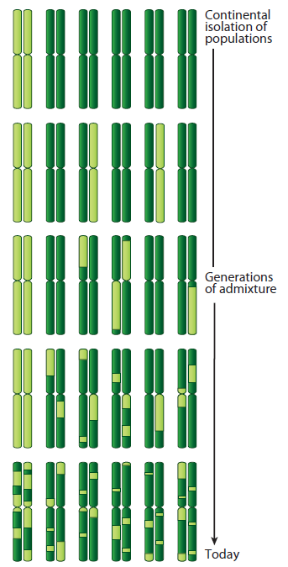
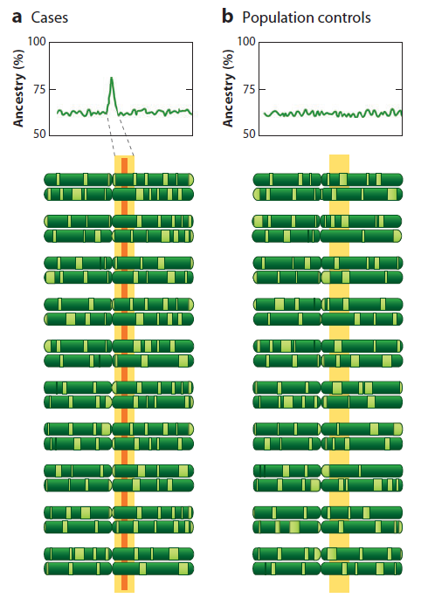
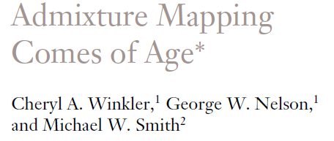
Admixture Mapping
Hypothesis: differences in disease rates between two ancestral populations are due in part to frequency differences in disease-causing genetic variants.
Causative genetic variants occur more often on chromosome segments inherited from the ancestral population with the higher disease variant frequency among individuals admixed from the two ancestral populations.
Only requires enough markers to identify the ancestral chromosome segments (e.g., African Americans = 1,500–2,500 ancestry-informative markers (AIMs)).

Slide 12
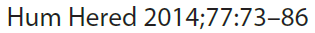
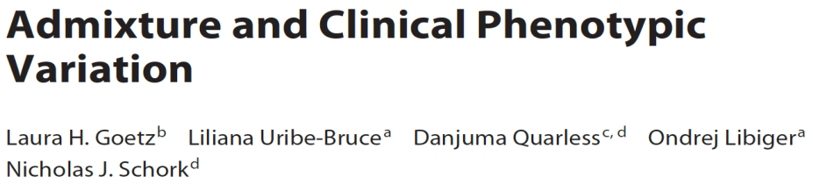
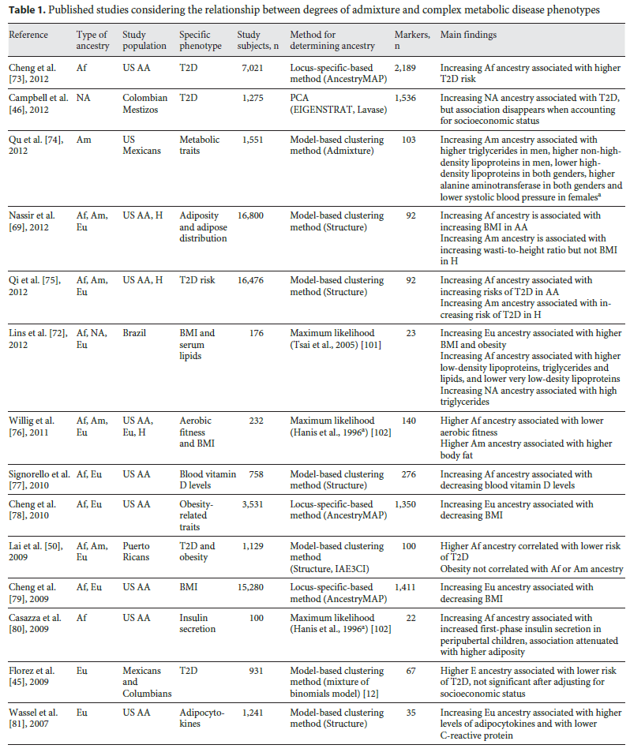
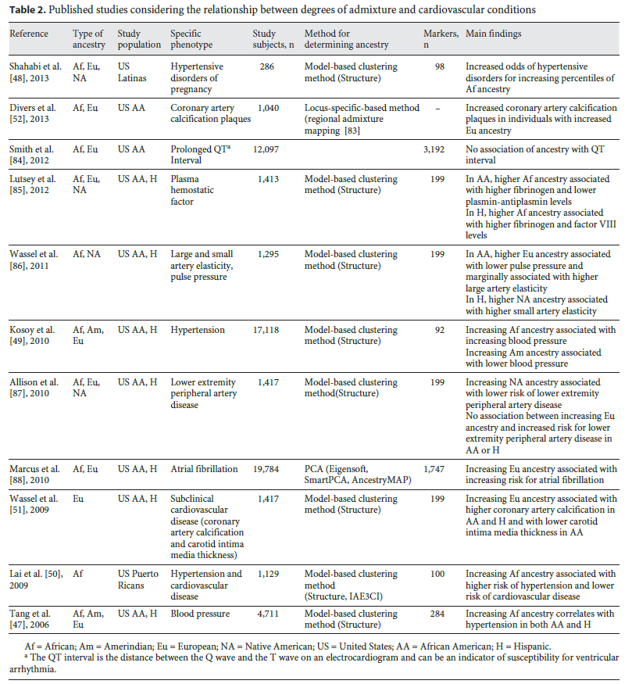

Slide 13
Race, Genetic Background, and Drug Prescriptions
Individuals from different races respond differently to drugs
It is thought that this is due to genetic differences
Historically, race was used as a guide for determining which drug a patient should receive

Slide 14
Native American Ancestry and Body Mass Index
Native Americans (NAs) have different body habitus and morphology than non-NAs
Body Mass Index (BMI) is thought to have a polygenic basis
NA communities exhibit genetic differentiation from non-NA communities
Many communities have admixed individuals (i.e., offspring from matings between, e.g., NA/non-NA)
Many cultural factors influence BMI (e.g., diet, lifestyle)
Question: Is BMI among NAs attributable in part to polygenes?
Approach: Correlate degree of NA ancestry among admixed individuals with BMI while controlling for cultural factors
Notes:
Mahalanobis distance

Slide 15
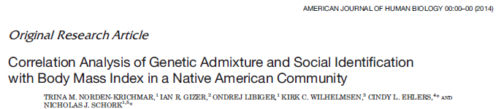
864 individuals from a Native American Community
BMI was measured on each individual
Two measures of genetic marker-informed NA ancestry:
Genetic cluster-based ADMIXTURE analysis (‘ADMIXTURE’)¹
Supervised 4 population-based ancestry assignments (‘ANC4’)²
Two measures of NA cultural identity:
Indian Culture Scale (‘ICS’)
Orthogonal Cultural Identification Scale (‘OCIS’)
Other covariates included: self-reported NA ancestry, sex, income and education
1. Pritchard and Rosenbegr. Am J Hum Genet. 1999 Jul;65(1):220-8.
2. Libiger and Schork. Front Genet. 2013 Jan 14;3:322.

Slide 16
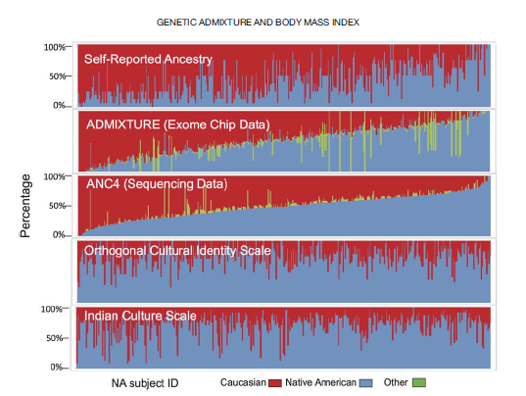
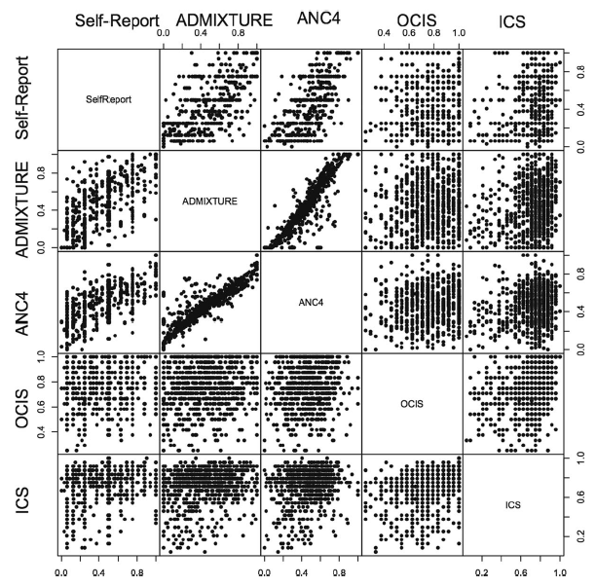
Correlations Between Measures of NA Identity

Slide 17
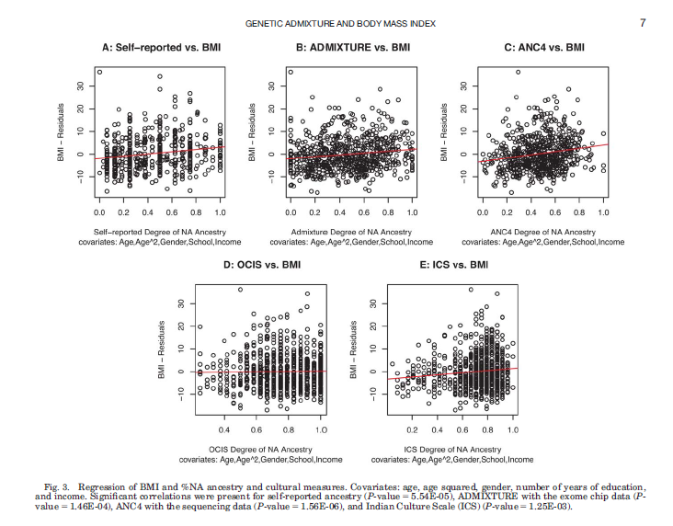
Correlations Between NA Identity and BMI

Slide 18
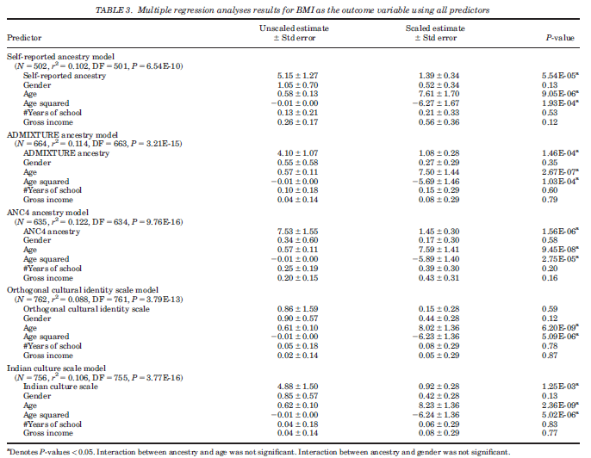
Multiple Regression Models Predicting BMI

Slide 19
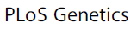
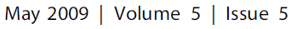
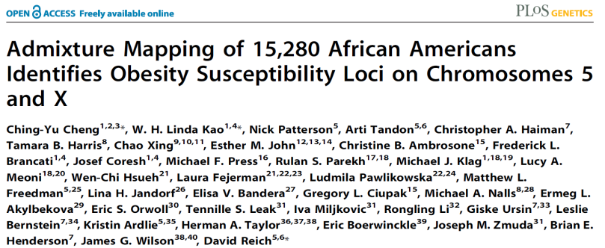
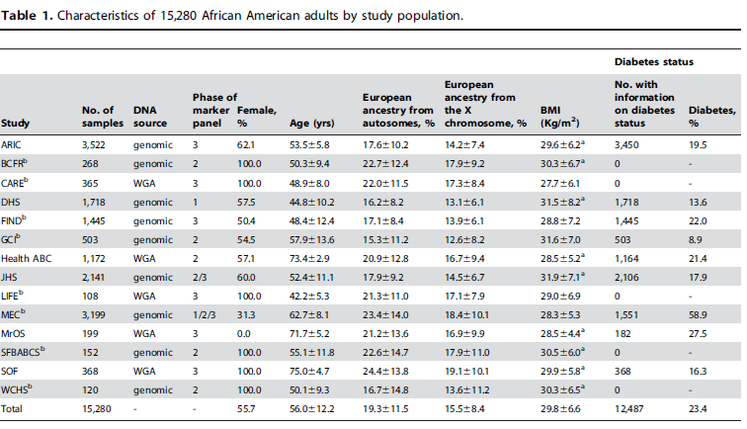
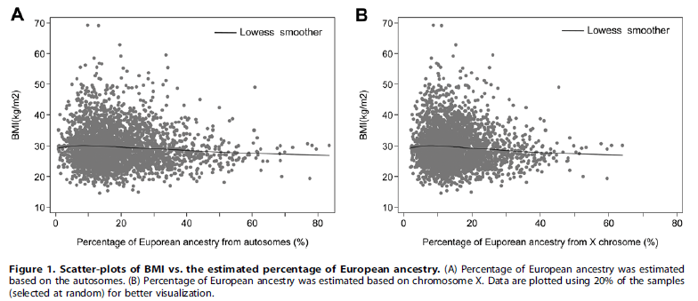
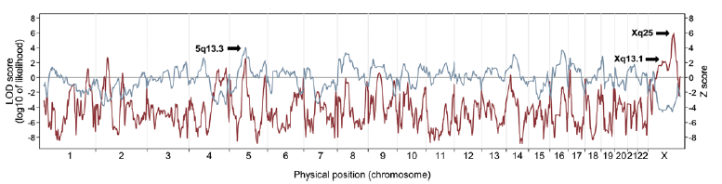

Slide 20
The Watson Genome, Genetic Background and the Phenotype of Humility

Slide 23
4. Population Genetics and Evolutionary Genetics: Integration and Impact

Slide 24
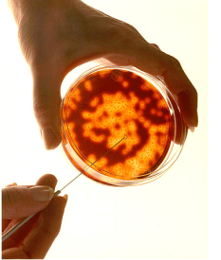
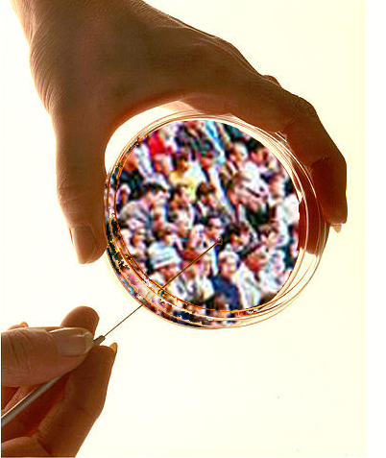
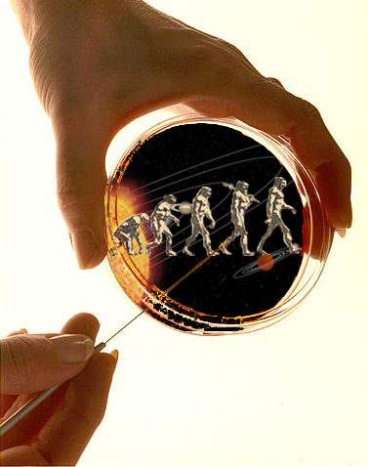
Population Biology is Ubiquitous…
Populations of Cells
Populations of Humans
Populations of Species
Population-level behavior occurs at all levels: interactions at different levels are key
Broader ‘systems-level’ thinking is needed to cross boundaries, draw inferences

Slide 25
How is genotypic/phenotypic differentiation maintained?
(population genetics, speciation, and mutation rates)
How do species develop? The compilation of functionally-significant mutations and selection/adaptation?
Mutation rate would have to be too high to explain all variation exhibited by a species
Sewall Wright devised brilliant theorems to explain the development of new phenotypes, speciation, and adaptive forces (The “Shifting Balance of Evolution Theory”).
Wright’s Theory Emphasizes:
Random processes, not directed processes
Combinations of mutations, not new mutations
Epistasis not single gene actions

Slide 26
(Random) Genetic Drift
(Sewall Wright)
C
A
A
T
C
G
An event leading to
subdivision occurs
T
G
T
T
A
A
C
G
T
G
T
A
A
A
T
A
T
C
T
T
A
G
T
C
A
A
A
A
C
C
A
C
A
A
A
G
T
A
T
C
Unique
Environments
A
G
C
T
T
A
T
C
T
C
A
C
C
T
G
T
T
G
T
T
A
C
C
C
T
T
A
T
T
T
T
C
C
C
T
C
T
C
T
C
A
T
T
Contemporary
Population
1
2
3
4
5
6
Time
T-frequency
25%
80%
50%
17%
0%
20%
Novel Phenotypes AAA TTTT CCTT CCTT - -

Slide 27
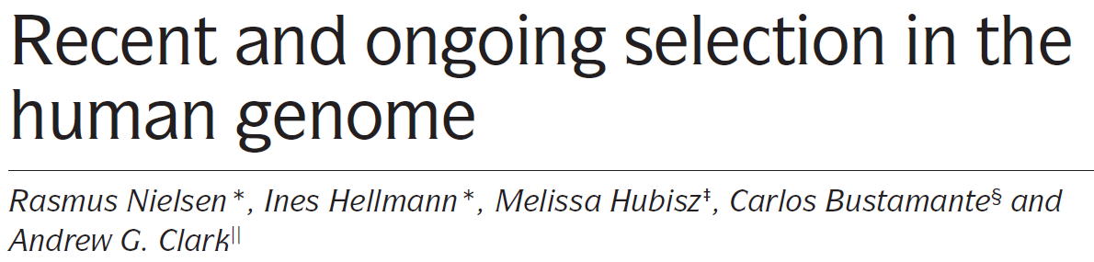
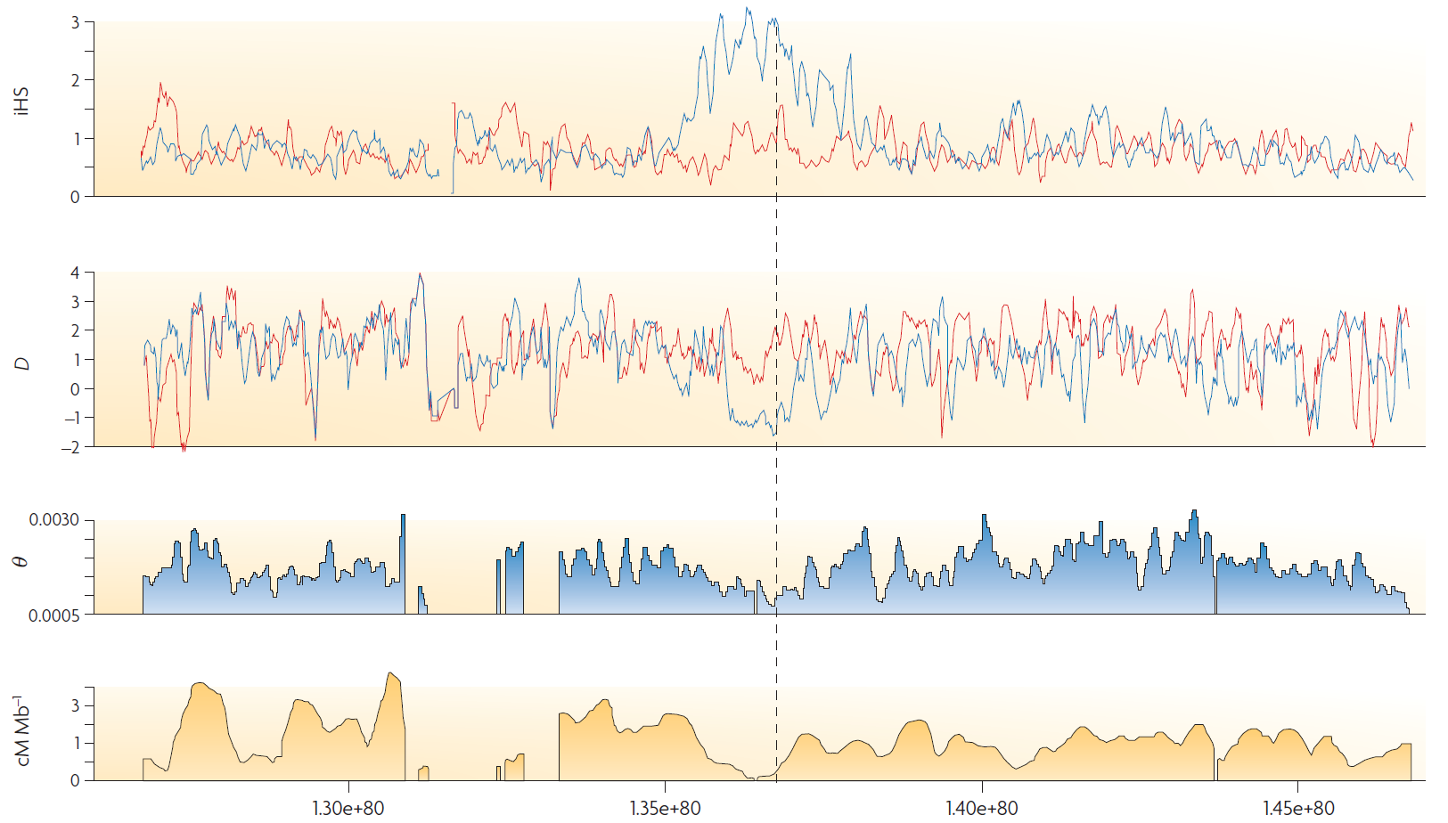
Lactase Gene (LCT)
Allele Frequency Differences
Across Populations
Reduction in Diversity, but Allele Frequency Differences Across Populations
Reduction Recombination

Slide 28
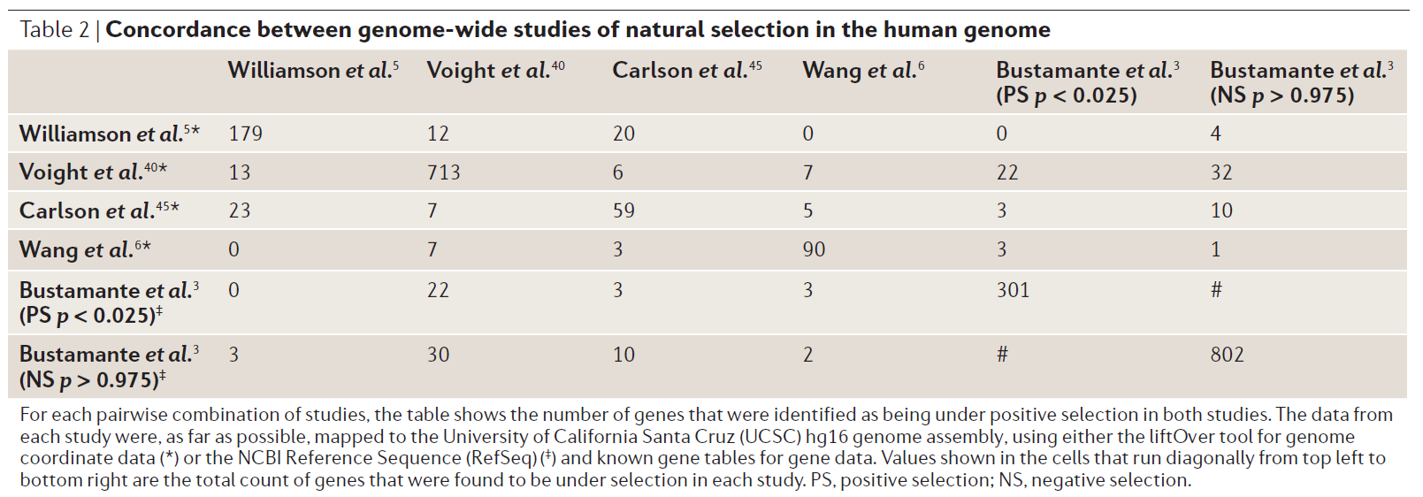

Slide 29
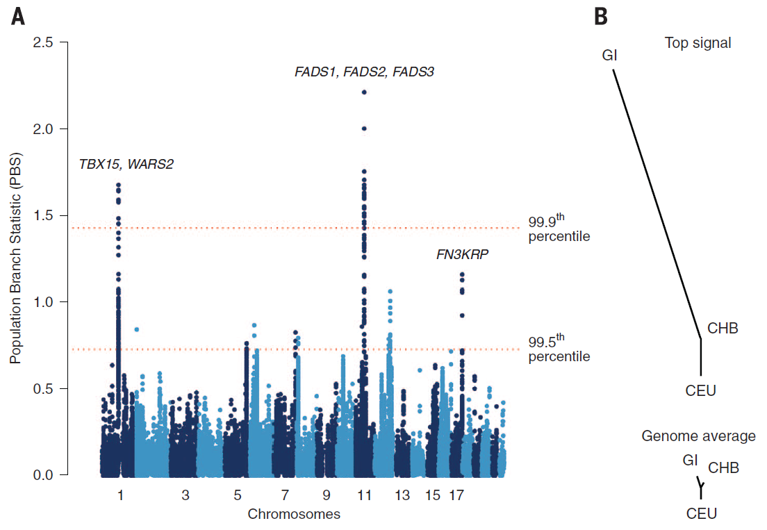
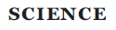
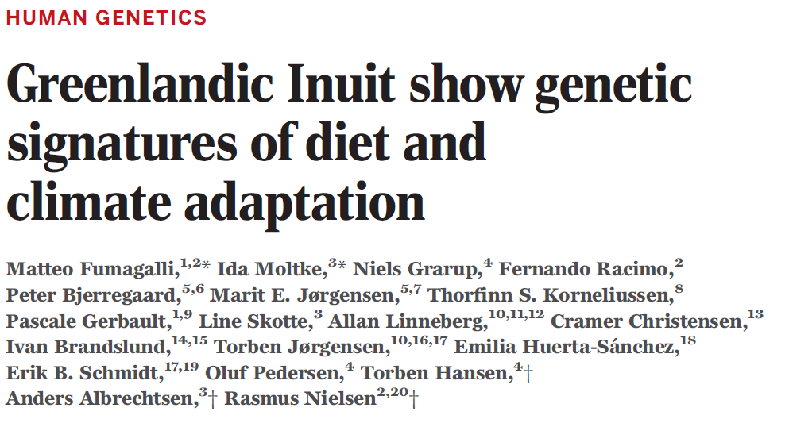
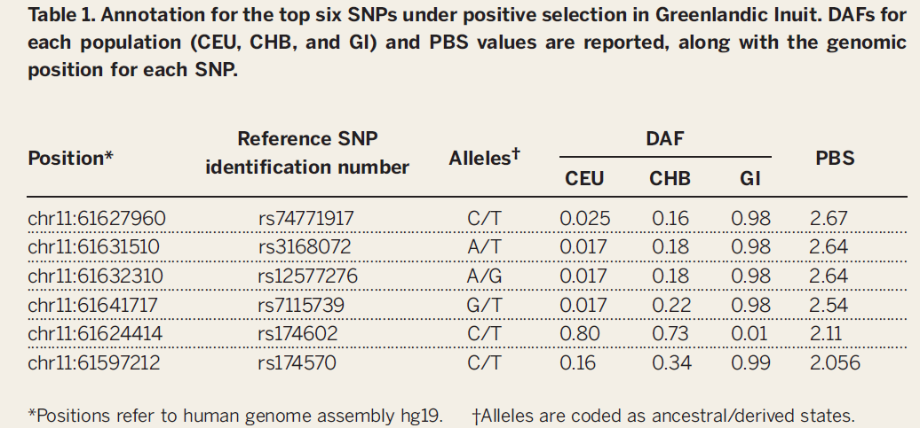

Slide 30
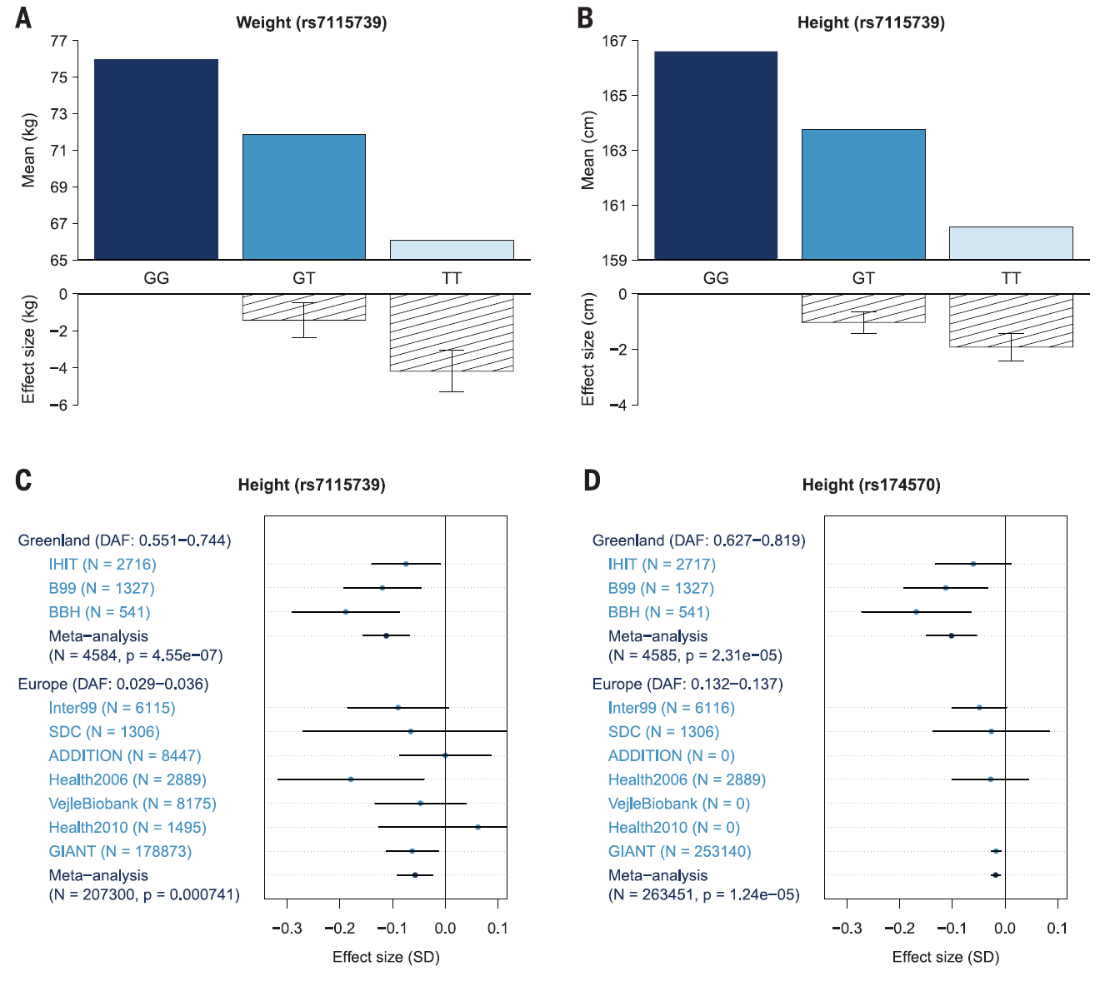
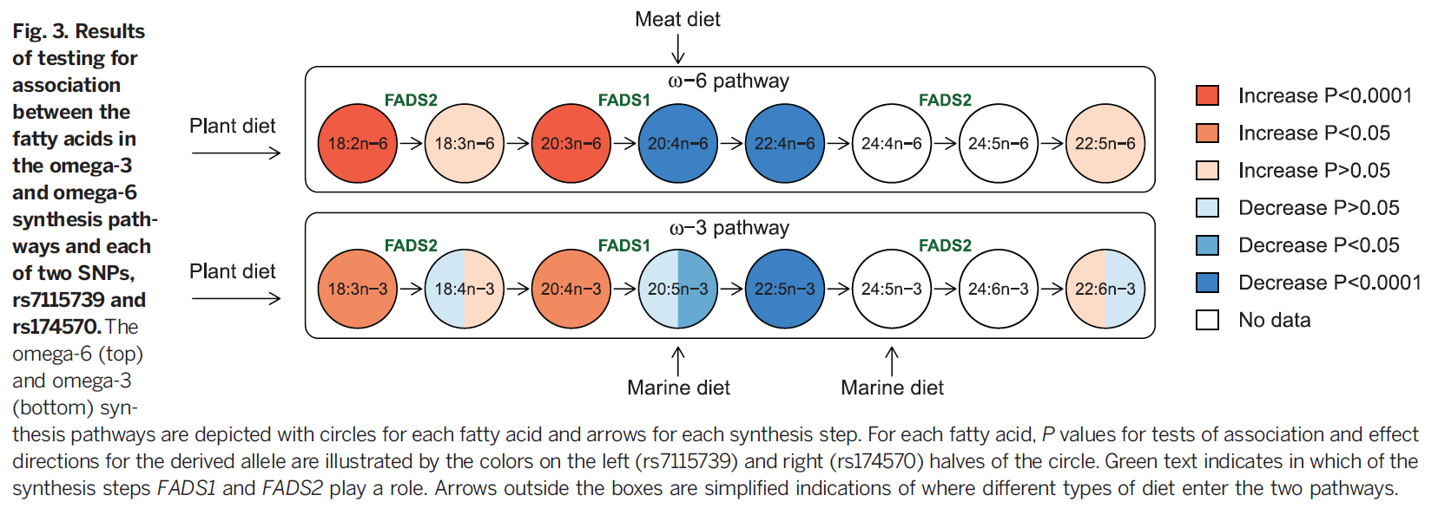

Slide 31
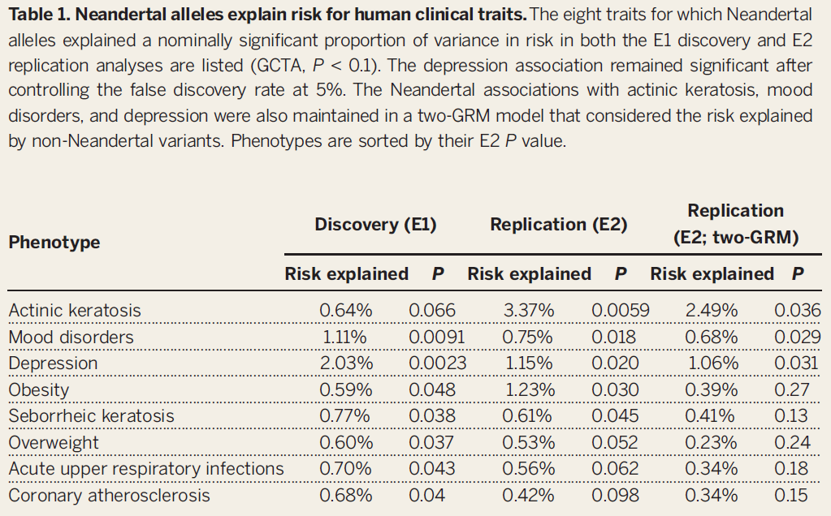
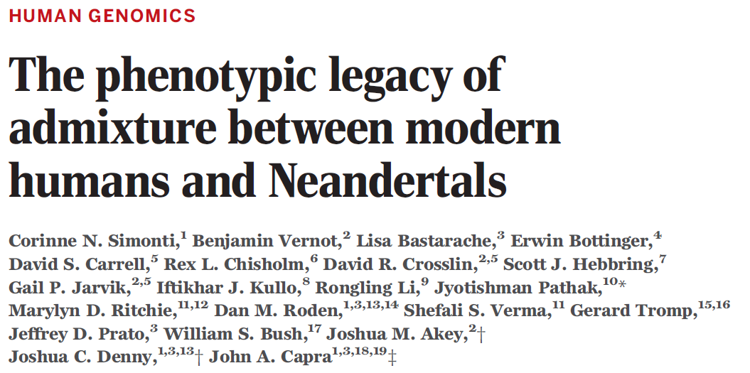
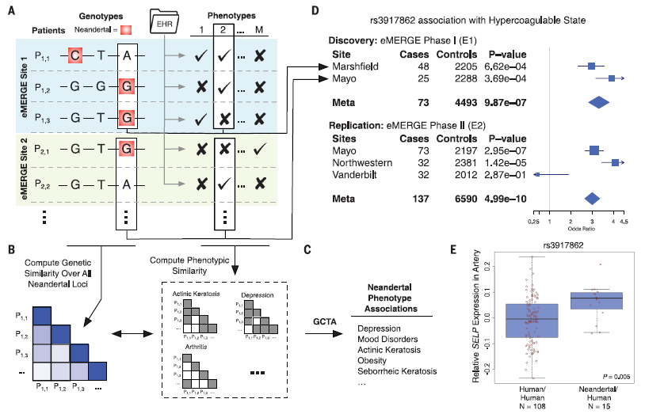

Slide 32
Evolutionary (or Darwinian) Medicine
Functional and/or mechanistic explanations for disease from an evolutionary perspective (e.g., address the question “why does disease exist?”)
Could impact potential palliative therapies, treatments, cures, social acceptance, etc.
Wiesenfeld SL (1967). Sickle-cell trait in human biological and cultural evolution. Development of agriculture causing increased malaria is bound to gene-pool changes causing malaria reduction. Science. 157(793):1134-40.
Williams N (2003). Evolution and disease. Curr Biol. 2003 Jan 8;13(1):R3-4.

Slide 33
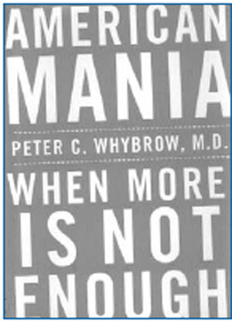
The “Thrifty” Genotype Hypothesis and the Maladapted “Fight or Flight” Response
The Thrifty Genotype Hypothesis:
Neel JV (1962). Diabetes mellitus: a "thrifty" genotype rendered detrimental by "progress“? Am J Hum Genet. Dec;14:353-62.
Stannard SR, Johnson NA (2004). Insulin resistance and elevated triglyceride in muscle: more important for survival than "thrifty" genes? J Physiol. Feb 1;554 (Pt 3):595-607.
Maladaptive Stress Response:
Korte SM, Koolhaas JM, Wingfield JC, McEwen BS (2005). The Darwinian concept of stress: benefits of allostasis and costs of allostatic load and the trade-offs in health and disease. Neurosci Biobehav Rev. Feb;29(1):3-38.
Whybrow PC (2005). American Mania: When More Is Not Enough. New York: W. W. Norton & Company.

Slide 34
Evolutionary (or Darwinian) Medicine

